Slide 1
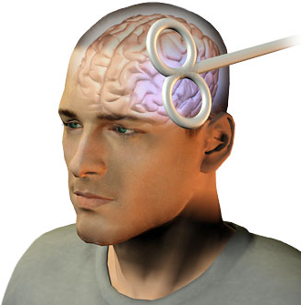
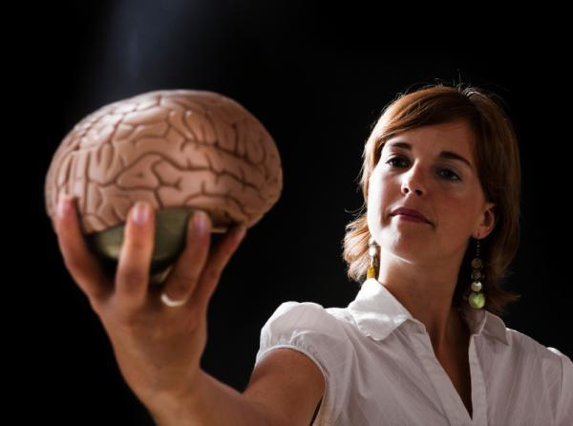
Neurological Disorders Lesson 1.1
How can we study our brains?

Slide 2
Welcome to the Neurological Disorders Module!
It has 5 units. Each unit lasts about a week and covers one of the critical questions we will need to answer if we want to understand neurological disorders.
Unit 1: Got Brains: What do our brains do?
Unit 2: What are the building blocks of our brains?
Unit 3: How do our neurons communicate with each other?
Unit 4: How do our neurons work together to control behaviors?
Unit 5: How do our choices change our brains?

Slide 3
Discussion
What does your brain do?
How do you know what your brain does?
How could you study your brain?

Slide 4
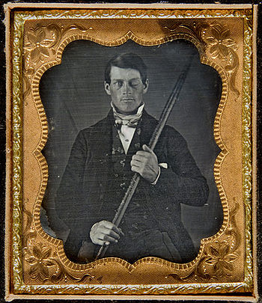
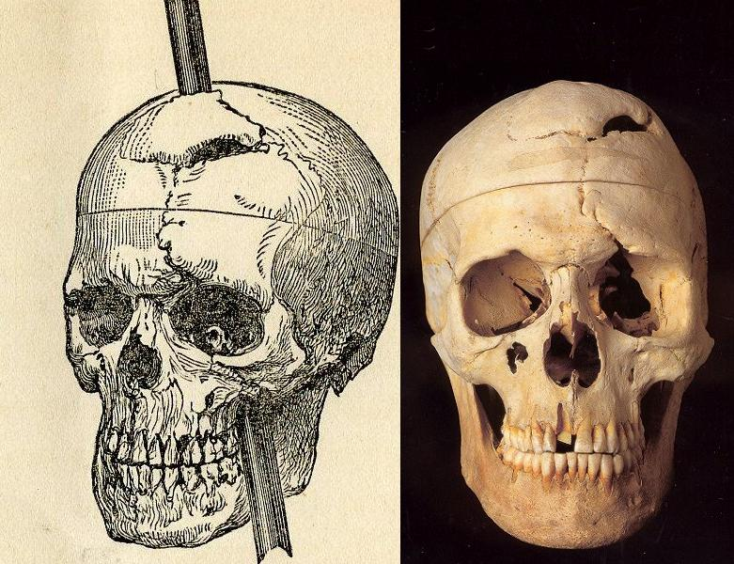
Phineas Gage
1823 - 1860
What can Phineas’s accident tell us about the brain and how it works?

Slide 5
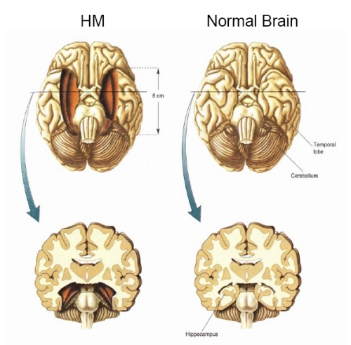
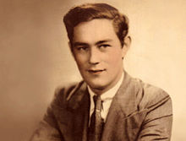
Patient H.M.
1926-2008
What can H.M.’s condition tell us about the brain and how it works?

Slide 6
Can we only study the brain using cases of injury or disease?
Notes:
If you are having difficulties playing this video through the PowerPoint slide, you can access it online at: http://sites.tufts.edu/greatdiseases/modules/neurological-disease/multimedia-backup/

Slide 7
Mind Control: Can we use what we know to control someone else’s brain?
Transcranial Magnetic Stimulation (TMS)

Slide 8
Mind Control: Can we use what we know to control someone else’s brain?
Notes:
If you are having difficulties playing this video through the PowerPoint slide, you can access it online at: http://sites.tufts.edu/greatdiseases/modules/neurological-disease/multimedia-backup/

